Slide 1
Machine Learning in Business John C. Hull
Chapter 2
Unsupervised Learning

Slide 2
Unsupervised Learning
In unsupervised learning we are not trying to predict anything
The objective is to cluster data to increase our understanding of the environment

Slide 3
Clustering Customers
Suppose you are a bank and have hundreds of thousands of customers and 100 features describing each one
Unsupervised learning algorithms can be used to divide your customers into clusters so that you can anticipate their needs and communicate with them more effectively

Slide 4
Feature Scaling (page 24-25)
Before using many ML algorithms (including those for unsupervised learning), it is important to scale feature values so that they are comparable.
Z-score scaling involves calculating the mean and SD from the values of each feature from the training set. Scaled feature values for all data sets are then created by subtracting the mean and dividing by the SD. The scaled feature values have a mean of zero and SD of one.
Min-max scaling involves calculating the maximum and minimum value of each feature from the training set. Scaled feature values for all data sets are then created by subtracting the minimum and dividing by the difference between the maximum and minimum. The scaled feature values lie between zero and one.

Slide 5
A Distance Measure
For clustering we need a distance measure
The simplest distance measure is the Euclidean distance measure. Distance =

Slide 6
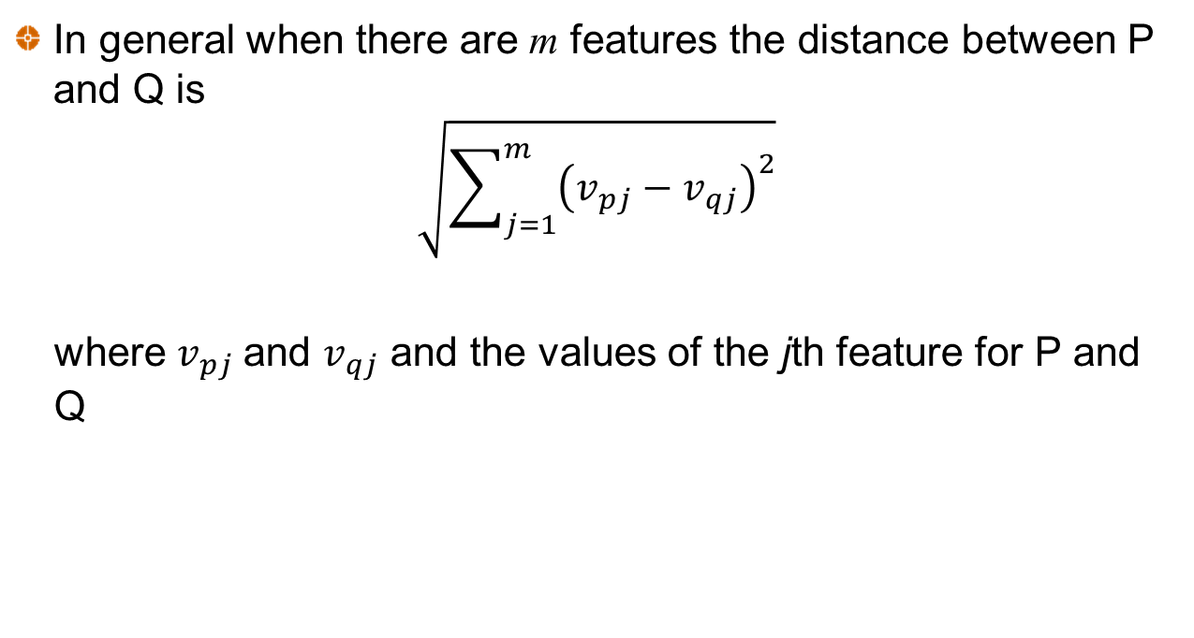
Distance Measure continued
In general when there are m features the distance between P and Q is
$$\sqrt{\sum_{j=1}^{m}{{\left(v_{pj}−v_{qj}\right)}^{2}}}$$
where $v_{pj}$and $v_{qj}$ and the values of the jth feature for P and Q

Slide 7
Cluster Centers (Table 2.1)
The center of a cluster (sometimes called the centroid) is determined by averaging the values of each feature for all points in the cluster. Example:
Observ. | Feature 1 | Feature 2 | Feature 3 | Feature 4 | Distance to center
1 | 1.00 | 1.00 | 0.40 | 0.25 | 0.145
2 | 0.80 | 1.20 | 0.25 | 0.40 | 0.258
3 | 0.82 | 1.05 | 0.35 | 0.50 | 0.206
4 | 1.10 | 0.80 | 0.21 | 0.23 | 0.303
5 | 0.85 | 0.90 | 0.37 | 0.27 | 0.137
Center | 0.914 | 0.990 | 0.316 | 0.330

Slide 8
k-means algorithm to find k clusters (Figure 2.2)
Choose k random points as cluster centers
Assign each observation to nearest cluster center
Calculate new cluster centers
End
Have cluster centers changed?
No
Yes

Slide 9
Inertia
For any given k the objective is to minimize inertia, which is defined as the within cluster sum of squares:
where d_{i} is the distance of observation i from its cluster center
In practice we use the k-means algorithm with several different starting points and choose the result that has the smallest inertia

Slide 10
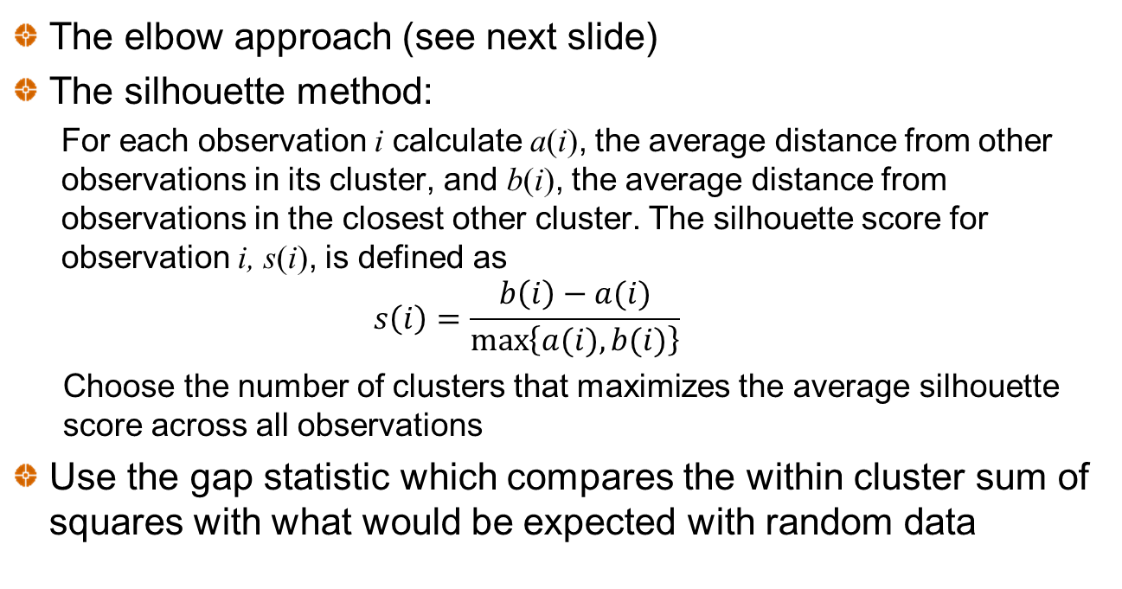
Choosing k
The elbow approach (see next slide)
The silhouette method:
For each observation i calculate a(i), the average distance from other observations in its cluster, and b(i), the average distance from observations in the closest other cluster. The silhouette score for observation i, s(i), is defined as
$$s\left(i\right)=\frac{b\left(i\right)−a(i)}{\max\left\{a(i),b(i)\right\}}$$
Choose the number of clusters that maximizes the average silhouette score across all observations
Use the gap statistic which compares the within cluster sum of squares with what would be expected with random data

Slide 11
The elbow method (In this example k=4 is suggested)

Slide 12
The Curse of Dimensionality (page 31)
The Euclidean distance measure increases as the number of features increase.
This is referred to as the curse of dimensionality
Consider two observations that have values for feature j equal to x_{j} and y_{j}. An alternative distance measure that always lies between 0 and 2 is

Slide 13
Country Risk Case
Objective is to cluster countries according to their riskiness for foreign investment
Measures of Country Risk
GDP growth rate (IMF)
Corruption index (Transparency international)
Peace index (Institute for Economics and Peace)
Legal Risk Index (Property Rights Association)
Collected data on 122 countries. Used Z-score scaling.

Slide 14
Corruption and legal risk were highly correlated
Therefore analysis based on
GDP growth rate
Peace index
Legal risk index
Legal
Corruption

Slide 15
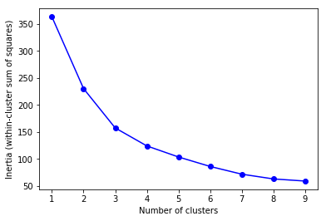
How the total within-cluster sum of squares declines as k increases when k-means algorithm is used (Figure 2.5)

Slide 16
Silhouette scores (suggest k=3)
Number of clusters | Average silhouette score
2 | 0.363
3 | 0.388
4 | 0.370
5 | 0.309
6 | 0.303
7 | 0.315
8 | 0.321
9 | 0.292
10 | 0.305

Slide 17
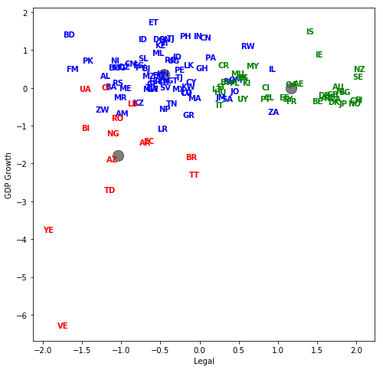
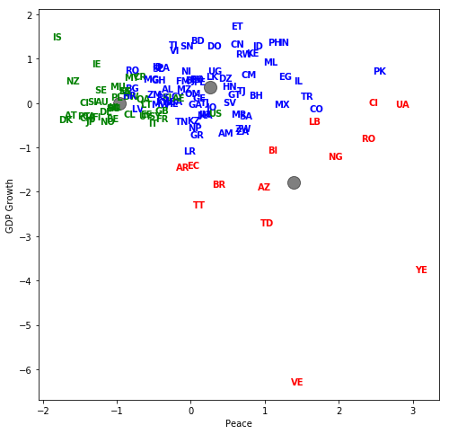
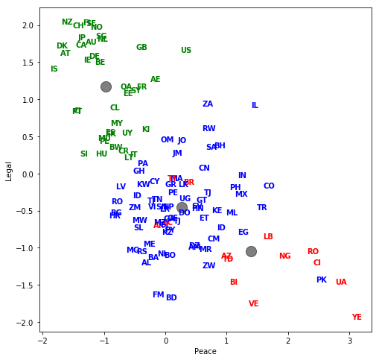
The three-cluster results
Green = Low country risk
Blue = Medium country risk
Red = High country risk

Slide 18
Cluster centers (scaled values) Table 2.5 Note that high values for the peace index are bad whereas high values for the legal risk index are good
 | Peace index | Legal index | GDP
High risk | 1.39 | −1.04 | −1.79
Moderate risk | 0.27 | −0.45 | 0.36
Low risk | −0.97 | 1.17 | 0.00

Slide 19
Hierarchical Clustering (page 37)
Start with each observation in its own cluster
Combine the two closest clusters
Continue until all observations have been combined into a single cluster
Can be implemented in Python with AgglomerativeClustering.
Measures of closeness of clusters:
Average Euclidean distance between points in clusters
Maximum distance between points in clusters
Minimum distance between points in clusters
Increase in inertia (a version of Ward’s method)

Slide 20
Density-based clustering
Forms clusters based on the closeness of individual observations
Unlike k-means the algorithm, it is not based on cluster centers.
We might initially choose 8 observations that are close. After that we add an observation to the cluster if it is close to at least 5 other observations in the cluster, and repeat.

Slide 21
Density-based Clustering Examples

Slide 22
Distribution-based Clustering
Assumes that observations come from a mixture of distributions and uses statistical procedures to separate the distributions

Slide 23
Principal Components Analysis
This is another approach to reducing the number of variables
PCA replaces a set of n variables by n factors so that:
Any observation on the original variables is a linear combination of the n factors
The n factors are uncorrelated
The quantity of a particular factor in a particular observation is the factor score
The importance of a particular factor is measured by the standard deviation of its factor score across observations
The idea is to find a few variables that account for a high percentage of the variance in the observations

Slide 24
Example: Daily interest rate changes

Slide 25
Interest rate changes continued
SD of factor scores
The fraction of the variance accounted for by first factor is
or about 90%.
The first two factors account for over 97% of the variance
PC1 | PC2 | PC3 | PC4 | PC5 | PC6 | PC7 | PC8
17.55 | 4.77 | 2.08 | 1.29 | 0.91 | 0.73 | 0.56 | 0.53

Slide 26
Application to Country Risk Case (Tables 2.11 and 2.12)
 | PC1 | PC2 | PC3 | PC4
Corruption index | 0.594 | 0.154 | −0.292 | −0.733
Peace index | -0.530 | 0.041 | −0.842 | −0.086
Legal risk index | 0.585 | 0.136 | −0.431 | 0.674
GDP Growth rate | 0.152 | −0.978 | −0.141 | −0.026
 | PC1 | PC2 | PC3 | PC4
SD of factor scores | 1.600 | 0.988 | 0.625 | 0.270
% of variance | 64% | 24% | 10% | 2%

